Slide 1
Top Level Performance
stefan.wiedemann@fiware.org

Slide 2
Agenda
Use-case analysis
Infrastructure
Testing
Repository walk-through

Slide 3
Know your use-case
Decide on the core measurements to optimize for
Read vs. Write
Focus on high frequency updates
Many parallel (retrieval) requests
Mixture of both
Update size and parallelity
Single entity/attribute updates
Batch updates (of varying sizes)
Few high-frequency clients
Many parallel clients

Slide 4
Know your use-case
Decide on the features required for the use-case
Subscriptions
Multiple Subscribers
Single/few subscribers
Complex subscription queries
Full data updates
Temporal representation of entities
Full History for every entity
History for subset only
Reduced density enough?
History retention/down-sampling

Slide 5



Be aware of your infrastructure
Flexibility for up and downscaling
Rolling updates
Automated(versioned) configuration and deployment
  https://github.com/FIWARE/helm-charts/tree/main/charts/orion
Images: https://commons.wikimedia.org, https://github.com/cncf/artwork

Slide 6





Be aware of your infrastructure
Operational tooling
  Logging
  Monitoring
  Alerting
Ingress
  Scale with the broker
  Support operational aspects
Persistence
  HDD vs. SDD
Images: https://commons.wikimedia.org, https://github.com/cncf/artwork

Slide 7
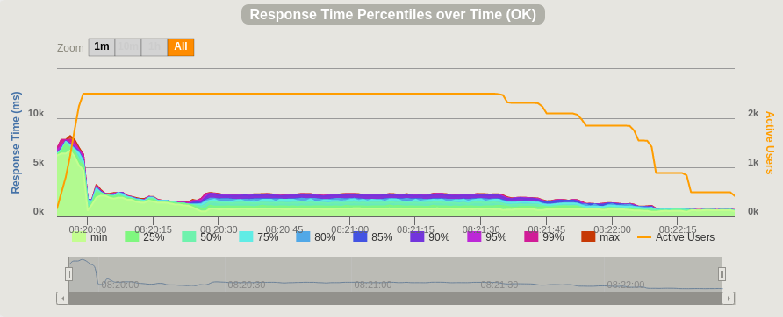
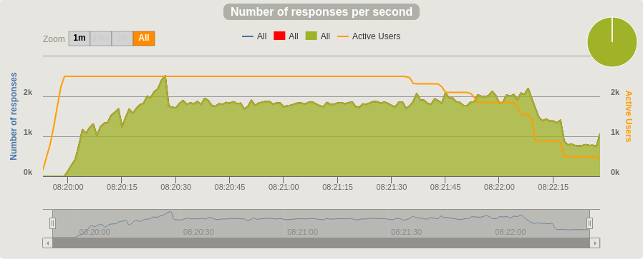
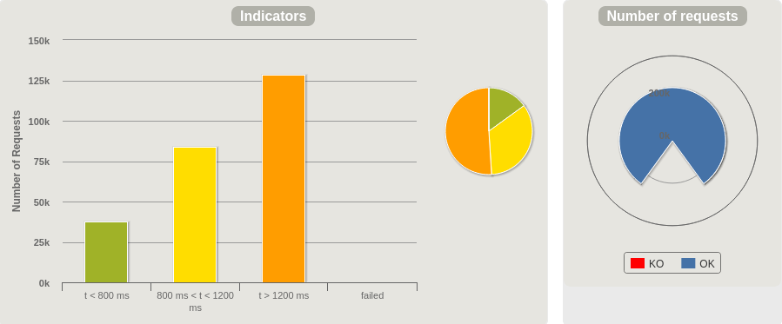
Test the assumptions
Load-tests for running against the NGSI-LD/V2 context broker
  https://github.com/FIWARE/orion-loadtest
  Gatling framework, multiple scenarios implemented
  Reports for multiple sizes available, including all configurations
Execute tests from local (mvn, gatling reporter)
Execute distributed in the cluster (via kubernetes jobs)
Can be used to evaluate different configurations for specific use-cases

Slide 8
Repository walk-through
Helm-Charts: https://github.com/FIWARE/helm-charts

Slide 9
Repository walk-through
Test-framework: https://github.com/FIWARE/orion-loadtest

Slide 10





DON’T MISS ONE SINGLE THING!
Twitter
Up your FIWARE know-how with the upcoming FIWARE Webinars
Never miss a beat!
Subscribe to our Newsletter
Follow us on
Facebook
Powering what’s next: Join
FIWARE Marketplace
Your gateway to funding!
Open calls
LinkedIn
Bring FIWARE into the University Community University Roadshow
Making great things
possible with
FIWARE Impact stories
YouTube
Be where we are!
Join FIWARE Events
Accelerate your success
with FIWARE Accelerator
GitHub

Slide 11
THANK YOU FOR JOINING US TODAY!
Have you got any further questions?
Do not hesitate to contact us: press.office@fiware.org

